Slide 1
What does he do on the weekend?
Study
He studies on the weekend.

Slide 2
What does he study on the weekend?
He studies math on the weekend.

Slide 3
What do they do at work?
Fight
They fight at work.

Slide 4
When does he clean the house?
Clean
He cleans the house in the mornings

Slide 5
What does he do in his free time?
Draw
He draws in his free time

Slide 6
What does she wait for in the mornings?
Wait
She waits for the bus.

Slide 7
What does she play in the afternoon?
Play soccer
She plays soccer in the afternoons

Slide 8
What does he cook in the mornings?
He cooks eggs for breakfast.

Slide 9
What instrument does he play in his free time?
He plays the piano in his free time

Slide 10
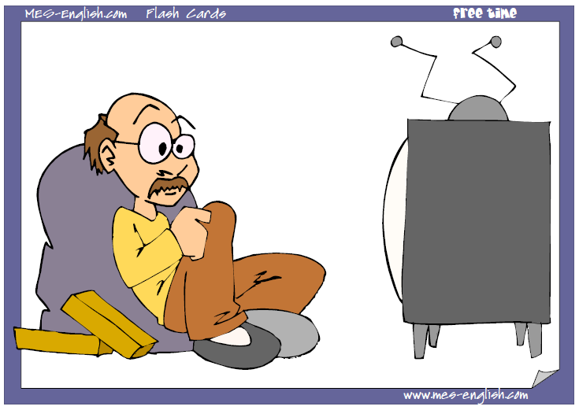
What does he do in his free time?
watch TV
He watches TV in his free time

Slide 11
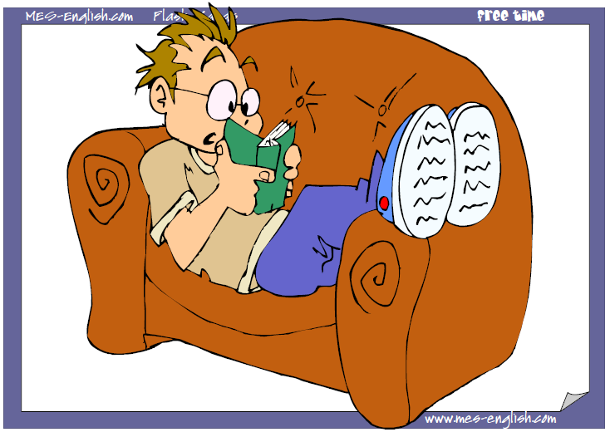
What does he do in his free time?
read
He reads in his free time

Slide 12
What does he read in his free time?
Science fiction books
He reads science fiction books in his free time

Slide 13
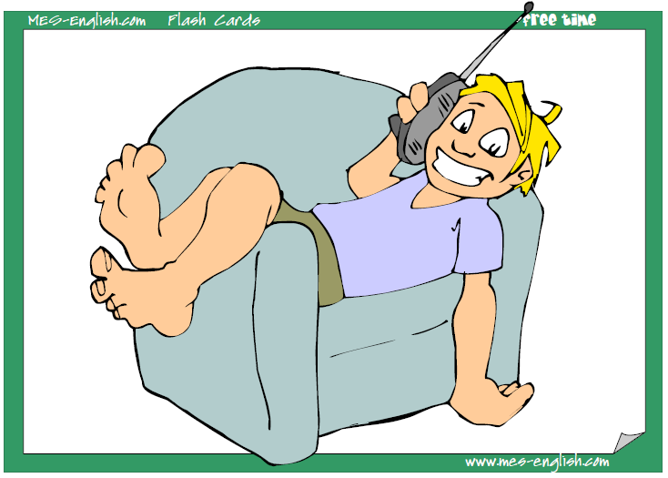
What does he do in his free time?
talk on the phone
He talks on the phone in his free time

